Slide 1
HNDIT11062 – Web Development
Week 3: Connecting to the Internet

Slide 2
Course Content
Internet service providers
Internet Connection Types

Slide 3
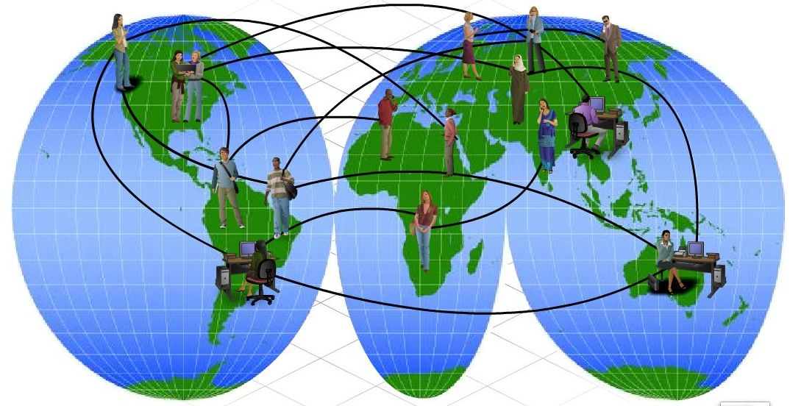
Internet
Users are connected to ISPs
ISPs are connected to other ISPs

Slide 4
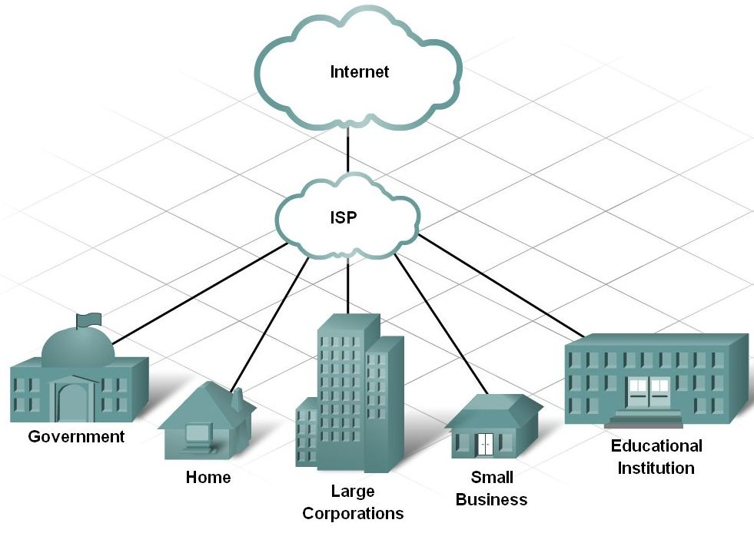
Internet service providers
Internet Service Providers
  Give users access to internet resources
  Allow organizations and individuals to publish information on the internet

Slide 5
Internet Connections
Wired
Wireless

Slide 6
Wireless Connectivity options
Wi-fi
Blue tooth
Cellular
Wi-Max
Radio Wave
Satellite
Wired Connectivity Options
Copper wire
Coaxial
Twisted pair
Fiber Optics

Slide 7
Internet Connection Types
Individual persons - Dialup Connections
        ADSL
Small organization – ADSL
            ISDN
            WIRELESS
Large organization – Leased line

Slide 8
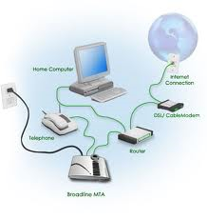
Wired Internet Connections
Dial-up connections
  Standard phone lines and a modem
  uses the facilities of the PSTN (Public Switched Telephone Network) to establish a dialed connection to an Internet service provider (ISP) via telephone lines.
  Computer dials a number for your ISP
  All Internet programs use the connection
  Applications might need configured
  A transient connection,
  because either the user, ISP
  or phone company
  terminates the connection.
  It may suit the purposes of the
  occasional Internet user without
  a need for a fast or consistent
  connection.
  Slow Speed
  Cheap

Slide 9
Wired Internet Connections…
High-speed broadband connections
  Very fast (faster than dialup)
  Offers speeds 700 Kbps or higher
  Allow the user to stay connected to the Internet at all times; the user need only open a browser window to access the Internet, as there is no log-on process to complete.
  Networks share the broadband connection
    All users access the same connection
    T or DSL lines common
  Home use increasing due to
    Lower cost
    Increased availability

Slide 10
Wired Internet Connections…
ISDN (Integrated Services Digital Network)
  Offers speeds up to 1.5 Mbps
  Uses standard phone lines
  Requires special equipment
  Simultaneous use of phone and data
  An international communications standard for sending voice, video, and data over digital telephone lines or normal telephone wires (copper wires).
  Offers circuit-switched connections (for either voice or data), and packet-switched connections (for data)
Notes:
Teaching tip
More information on ISDN can be found on webopedia.com/TERM/I/ISDN.html.

Slide 11
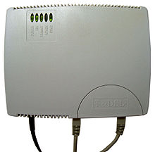
Wired Internet Connections…
DSL (Digital Subscriber Line)
  Offers speeds up to 30 Mbps
  provides digital data transmission over the wires of a local telephone network
  Uses modified phone lines
    Needs special DSL modem
  Simultaneous use of phone and data
xDSL - Refers collectively to all types of DSL
- new digital service that uses high-bandwidth to bring voice, video and data to your business.
- two main categories being ADSL and SDSL
- Two other types of xDSL technologies are High-data-rate DSL (HDSL) and Very high DSL (VDSL).
Notes:
Teaching tip
For more information on dsl see www.dslreports.com.

Slide 12
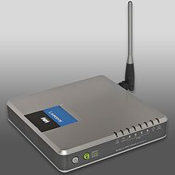
  ADSL (Asynchronous DSL or Asymmetric DSL)
    Different up and download speeds (i.e. 608/128, 1500/384)
    Usually used for residential service, since residential customers don't need to upload much
  SDSL (Synchronous DSL or Symmetric DSL)
    upstream and downstream speeds are equal (i.e. 1.5M/1.5M)
    Usually used for business service
    ADSL and SDSL are very affordable and cost-effective services
    based upon a flat rate and also they are easily and inexpensively installed.
  Variable DSL
              Speed changes based on traffic

Slide 13
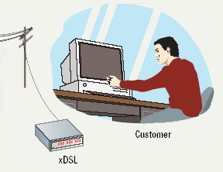
DSL Connections

Slide 14
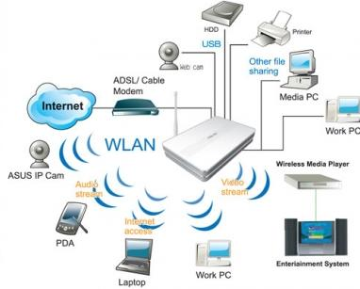
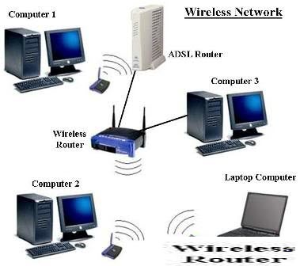
ADSL wireless network
ADSL wired network

Slide 15

Wired Internet Connections…
Cable modems
  Speeds up to 3 Mbps
  Uses cable TV wires
  Requires a cable modem
  Simultaneous use of TV and data

Slide 16
Wired Internet Connections…
Leased line
  A permanent fiber optic or telephone connection between two points set up by a telecommunications carrier
  Sometimes referred to as a ‘dedicated line’
  Can be used for telephone, data, or Internet services
  Oftentimes businesses will use a leased line to connect to geographically distant offices because it guarantees bandwidth for network traffic.
  e.g. A bank may use a leased line in order to easily transfer financial information from one office to another.
  Do not have telephone numbers because each side of the line is always connected to one another, as opposed to telephone lines which reuse the same lines for numerous conversations through a process called "switching."
  The fee for the connection is a fixed monthly rate. (The primary factors affecting the monthly fee are distance between end points and the speed of the circuit)
  provide a guaranteed level of service and speed, offering fast data transfer over a completely secure connection at a price that can be cost effective for very heavy internet users

Slide 17
Software Accessing The Internet
Application programming interface (API)
  Simplifies connection to network devices
  Allows any application to access Internet
  UNIX API uses sockets
  Windows API uses winsock
Notes:
Insider information
A socket (UNIX or Windows) is a combination of an IP address and a port. For example, connecting to the HTTPS port on machine 192.168.110.15. The socket is 192.168.110.15:443.

Slide 18
Software Accessing The Internet
Network drivers
  Control access to the hardware
  Ethernet and dial-up require a driver
  API connects to the driver

Slide 19
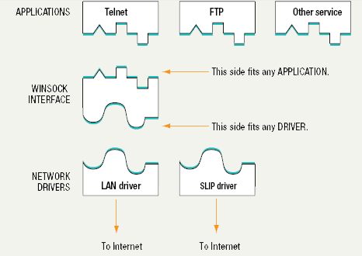
API and Drivers

Slide 20
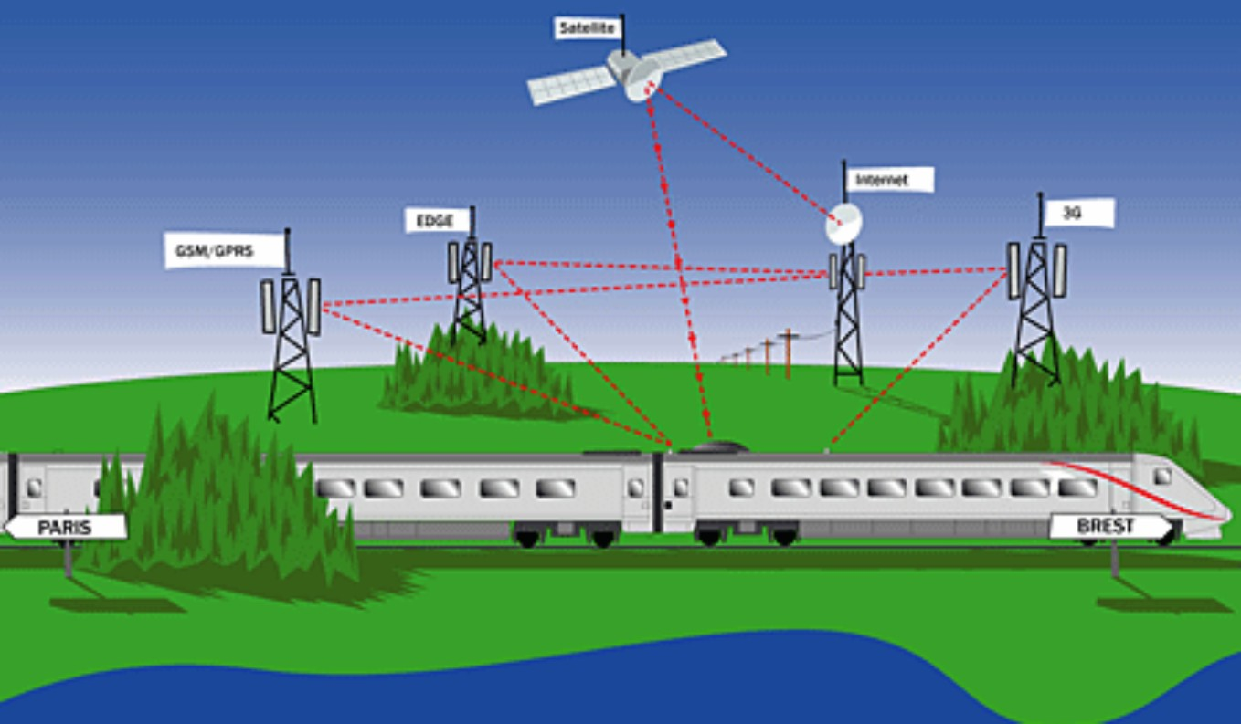
Wireless Internet Connection
Wireless network refers to any type of computer network that is not connected by cables of any kind.

Slide 21
Wireless Internet Connection…
Wireless WAN (WWAN)
  Wireless network over a large area
  Uses radio signals to transfer data
  Speeds range from 1 to 100 Mbps
  Antennas required
  Subject to atmospheric disturbances
Wireless MAN (WMAN)
  A type of wireless network that connects several Wireless LANs
  WiMAX : A type of Wireless MAN described by the IEEE 802.16 standard.
Notes:
Teaching tip
Grok Technologies of Pittsburgh PA provides a good example of WWAN plans. Visit www.groktechnologies.com for more information.

Slide 22
Wireless Internet Connection…
Wireless LANs (WLAN)
  Network without wires
  Connects to a broadband LAN connection
  WAP are wired directly into the LAN
  Nodes use wireless
  Wi-Fi: A term used to describe 802.11 WLANs

Slide 23
Wi-Fi
  Wireless Fidelity
  wireless networking technology that allows computers and other devices to communicate over a wireless signal.
  Wi-Fi connection only exists between the device and the router.
  Most routers are connected to a DSL or cable modem, which provides Internet access to all connected devices.
WiMAX
  Worldwide Interoperability for Microwave Access
  A communications technology that uses radio spectrum to transmit tens of megabits per second in bandwidth between digital devices such as laptop computers.
  Similar to WiFi, WiMAX brings with it the ability to transmit over far greater distances and to handle much more data.

Slide 24
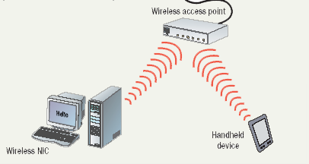
Wireless LAN

Slide 25
Wireless Internet Connection…
Satellite services
  Internet access in remote regions
  Suitable for home and office use
  Needs a VSAT at the client
    Very Small Aperture Terminal
    Connects to the satellite
  Modem connects to the VSAT
  Need satellite dish and a service provider contract
  Can be frustrating to set up
  Need a phone line for upstream data and limited to analog modem speeds
  Satellite services are not inexpensive
  High speed connection. But usually slower than cable and DSL connections.
  Most popular in areas in which cable or DSL connections are unavailable or unreliable.
Notes:
Teaching tip
Satellite services are not inexpensive. Www.groundcontrol.com is one site offering satellite Internet services.

Slide 26
Wireless Internet Connection…
Wireless security
  Crucial to protect wireless transmissions
  Encryption protects transmissions
  Wireless Encryption Protocol is quite weak
  Wi-Fi Protected Access is stronger
  MAC address of trusted computers
  War driving

Slide 27
lesson review
Compare and contrast wired internet connections and wireless internet connections.
List advantages and disadvantages of each type of wired and wireless internet connections.

